Slide 1
Notes:
FACILITATOR NOTE:
Please review slides in advance to ensure you are familiar with the content and details. Please don’t hesitate to send questions to LoveYourTree@ercpathlight.com

Slide 2
Love Your Tree is a creative arts-based workshop for people of all ages focused on cultivating self-compassion, body acceptance and positive mental well-being through creativity, community connections, and self-reflection.
Notes:
Love Your Tree is a creative arts-based workshop that focuses on the connection humans have with every tree in the forest. Through participation in Love Your Tree, we are encouraged to explore the tree metaphor and share creative expressions of our creativity, community connections, and self-reflection through self-compassion, body acceptance, and positive mental well-being.

Slide 3
THE 5 BRANCHES
Notes:
The Love Your Tree workshop is embracing 5 qualities and characteristics of trees that we can embrace together and apply to our own lives.

Slide 4
Self-Exploration & Creative Brainstorm Sheet
In the next few steps, we are going over this Self-Exploration & Creative brainstorming worksheet
Notes:
FACILITATOR NOTE:
Tell attendees to pull out their brainstorming worksheet.
Download & Print these activity sheets at www.loveyourtree.org …or simply have participants use a blank piece of paper and the prompts in this presentation as a guide.

Slide 5
LET’S GET STARTED…

Slide 6
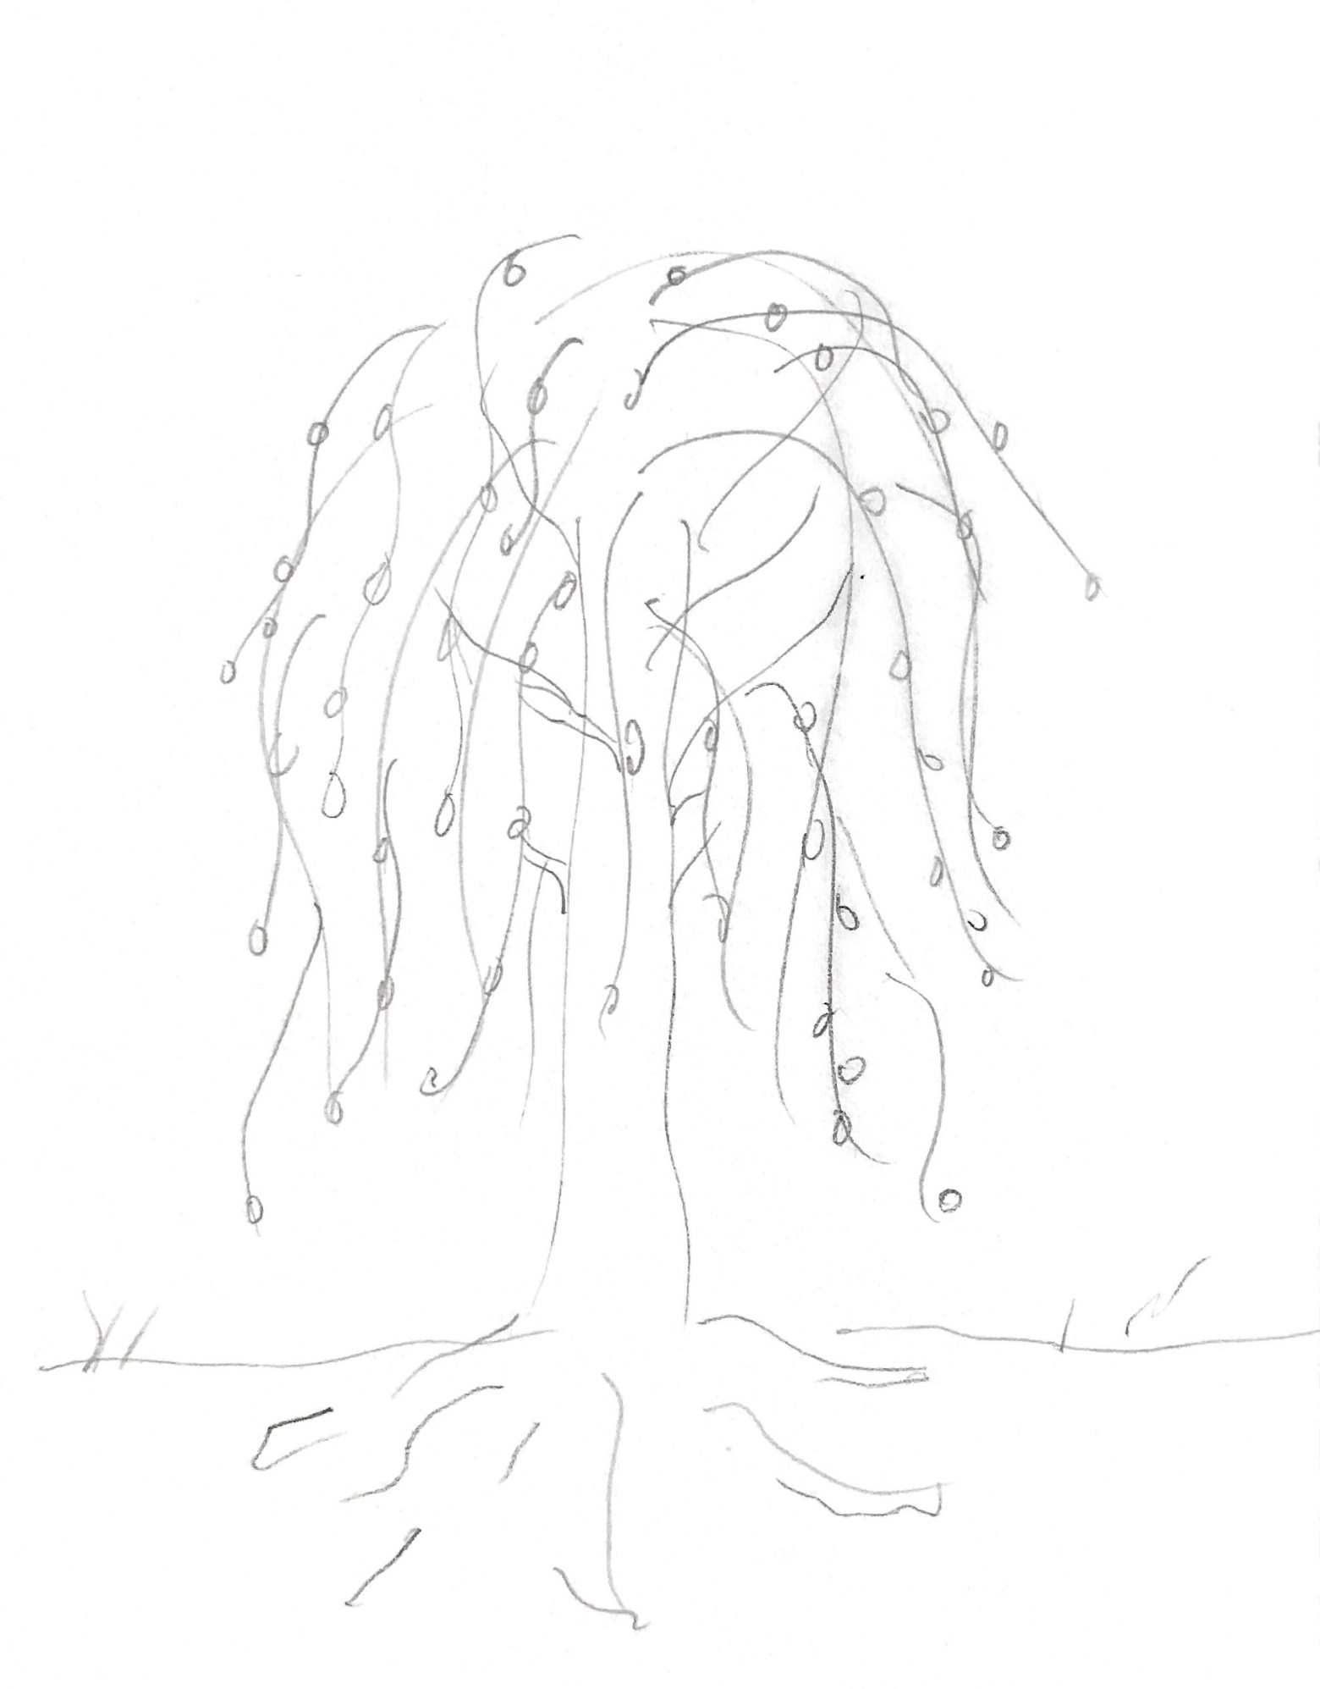
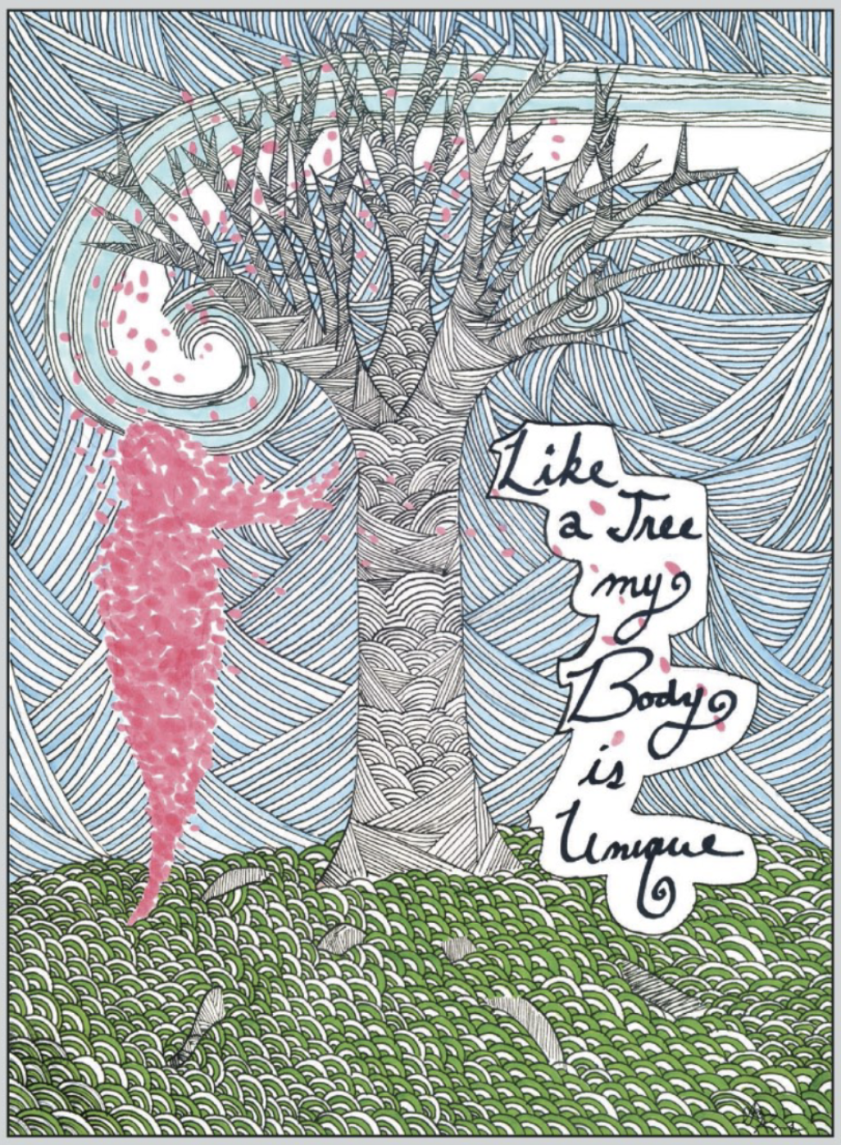
Step 1: Quickly sketch a tree
Artwork by: Anna Karwacki, 2014
Notes:
Let’s get started on our activity sheets with #1, sketch a tree. This may be your favorite kind of tree, a memory of a tree. It can be accurate or your interpretation and does not need to include a bunch of details, this is just a quick sketch.

Slide 7
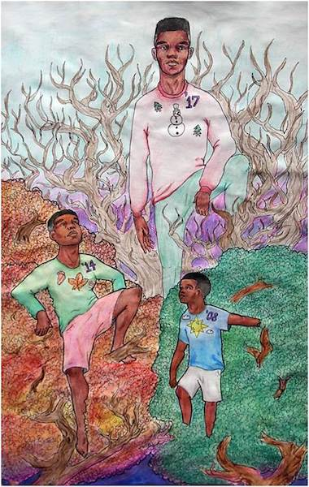
Love Your Tree
#2. In what ways are you connected to your favorite tree?
Artwork by: Agyeman Nyanteh, 2018

Slide 8
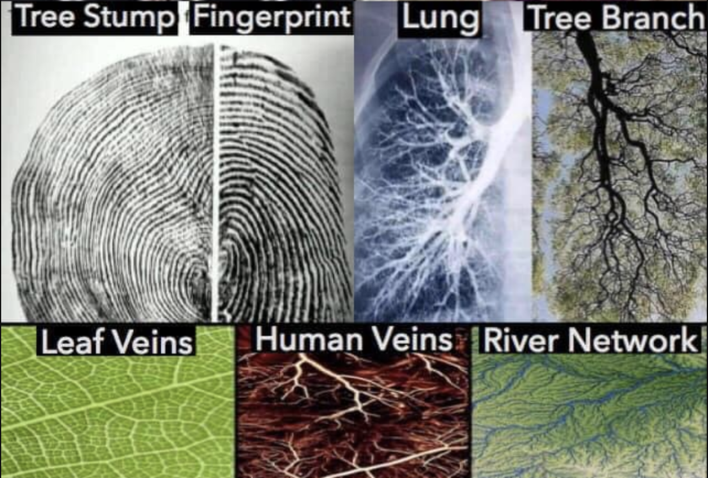
Many natural connections and comparisons can be made between trees and humans!
#3. What is your favorite part of the tree?
Think about all parts of the tree, the parts you can see and not see, the parts you can feel and not feel.
Notes:
There are many natural comparisons and connections between humans and trees. For instance, the connection between the rings of a tree stump and our fingerprints, human veins and leaf veins, tree branches and the branches in the lungs. #3 asks you to select your favorite part of the tree from the parts listed or feel free to write in your own. You can select more than one.

Slide 9
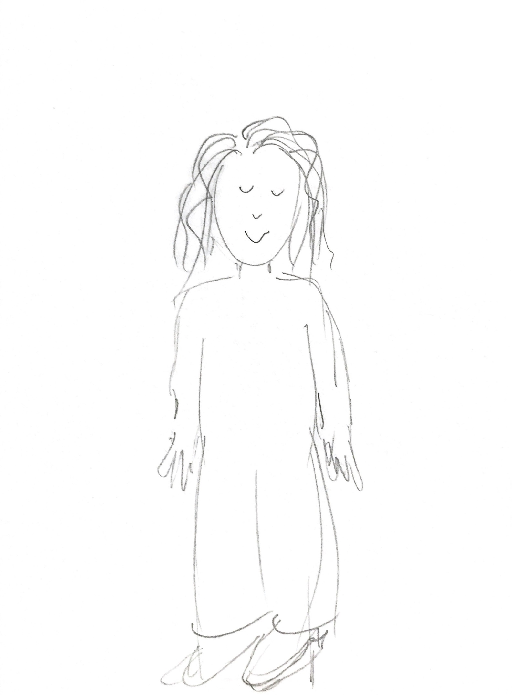
#4: Quickly sketch yourself!
Artwork by: Ayana Owens, 2009
Notes:
#4, sketch a yourself. This may be your full body, your just your head. This may be you today, you in the past or you in the future. It can be accurate or your interpretation and does not need to include a bunch of details, this is just a quick sketch.

Slide 10
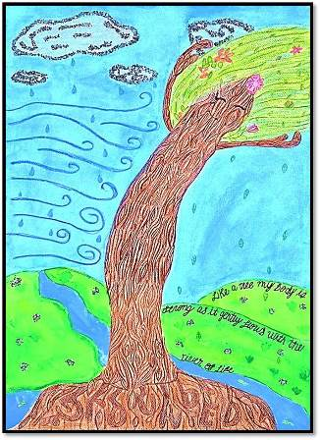
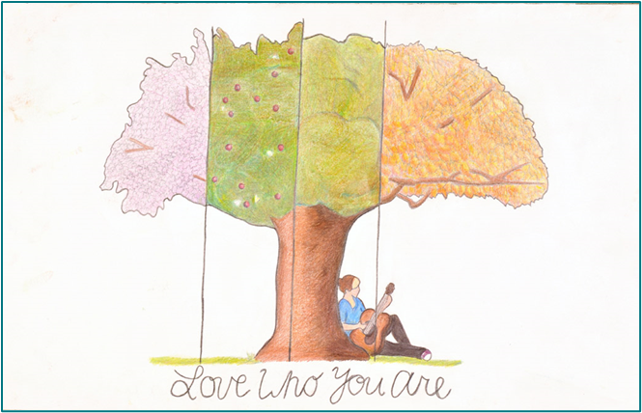
Love Your Tree
#5. What is your favorite part of your body?
Think about the parts we can see and not see
Artwork by: Victoria Miller
Notes:
#5 on our activity sheet asks what is your favorite part of your body, as you answer this, think about the parts we can see and the parts we cannot see. Select from those listed or list your own. You can select more than one.

Slide 11
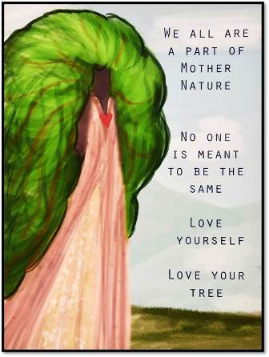
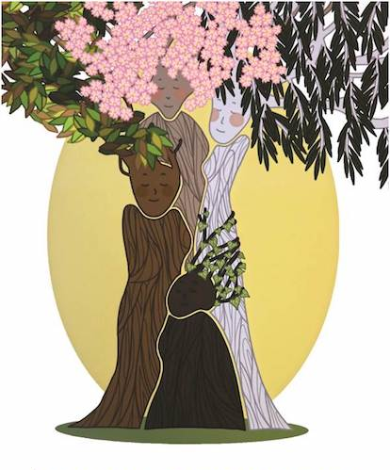
Love Your Tree
#6. Write down 3 words to describe that body part and what it supports you to do?
Think about something that you makes you unique or different?
Artwork by: Crystal Weyant
Artwork by: Laura Sinton, 2018
Notes:
#6 Write down three words that describe the body part or parts that you selected in #5. All word are accepted, give some acknowledgment to what makes you unique and different, and what keeps you connected to others.

Slide 12
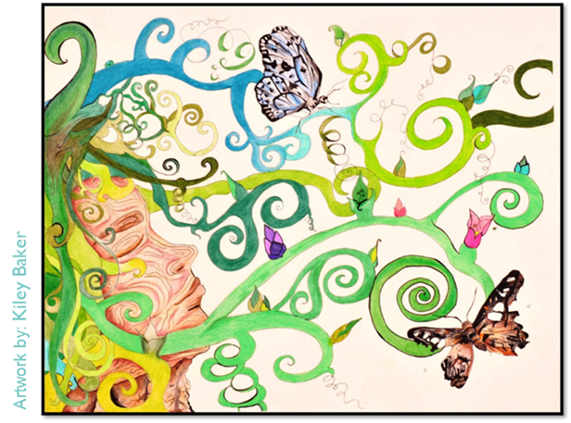
Love Your Tree
#7. What are your favorite characteristics of your personality?
Notes:
#7 Select your favorite characteristic of your personality from the list or add in your own. You can select more than one.

Slide 13
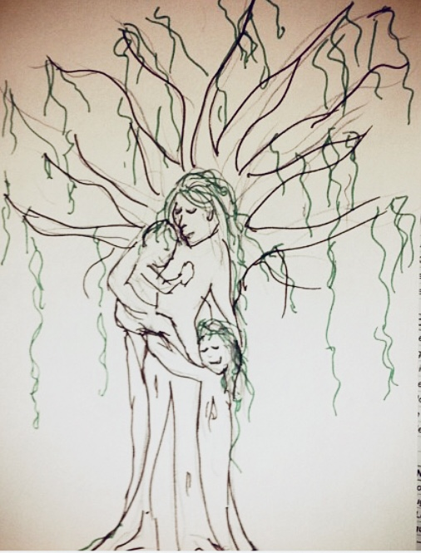
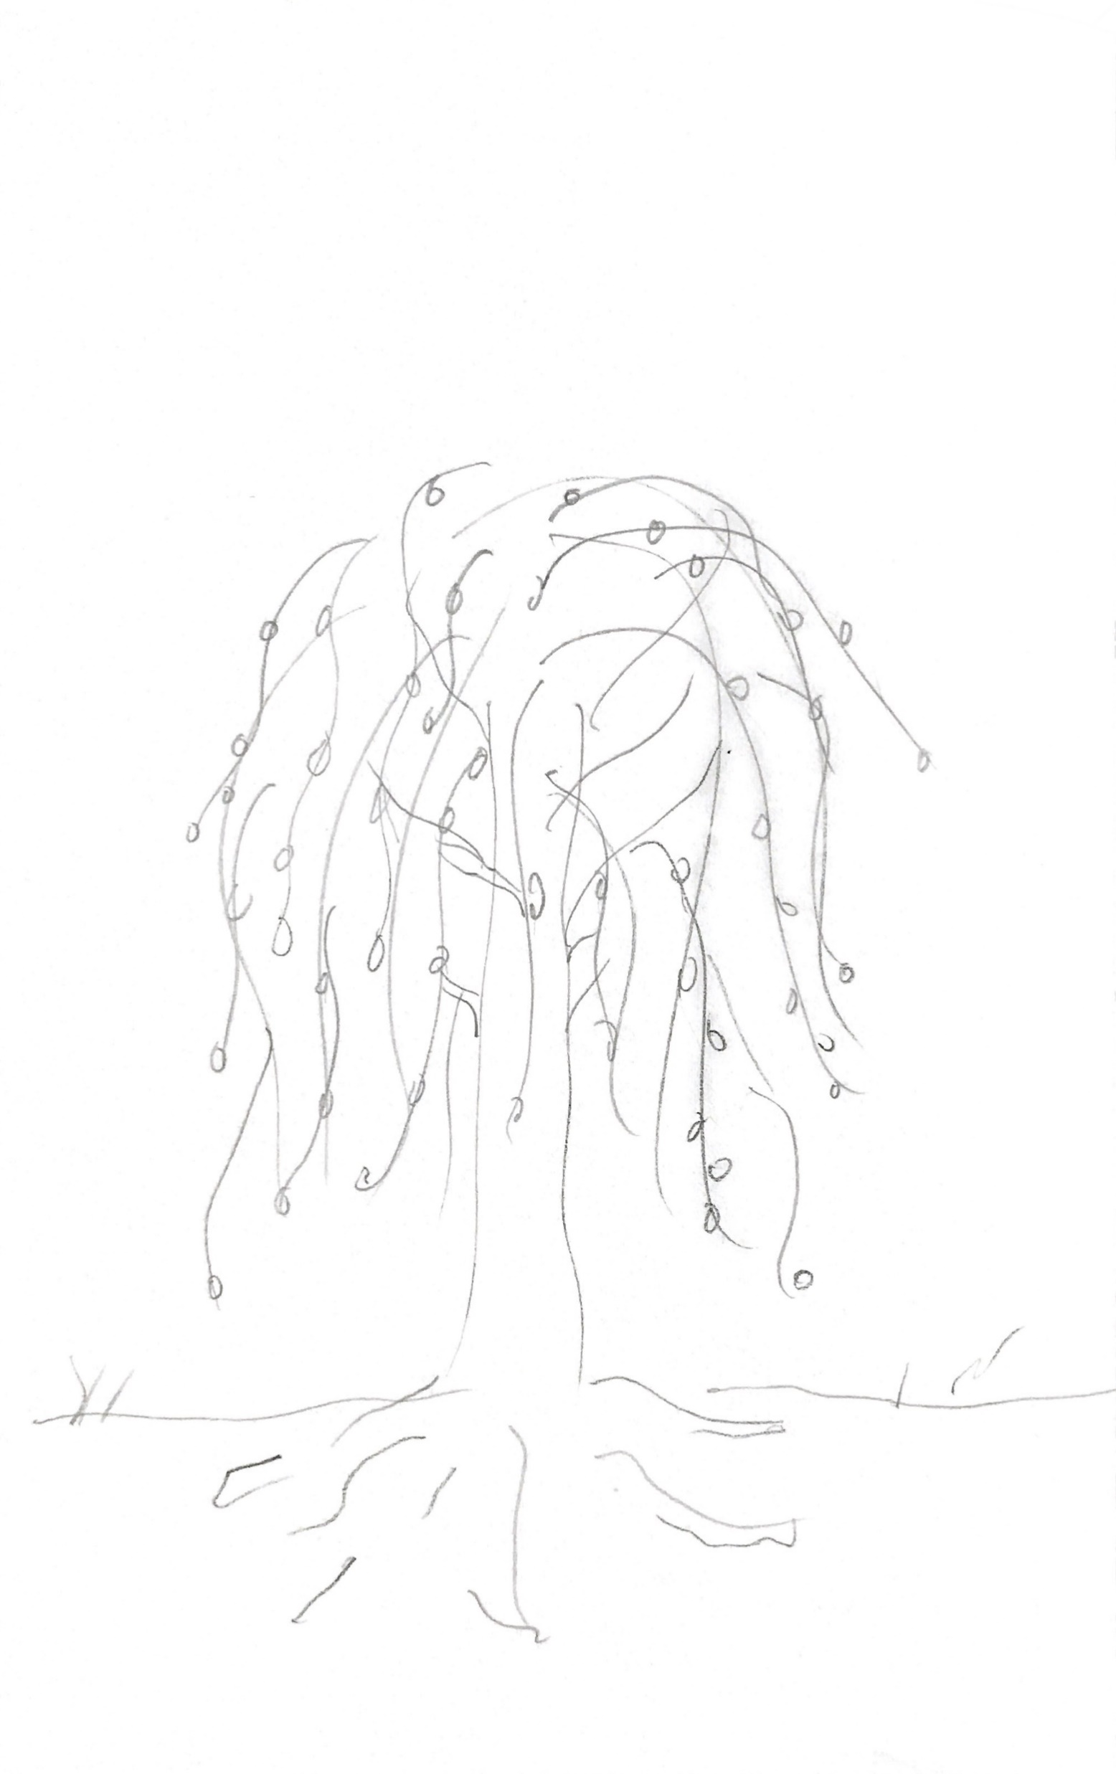
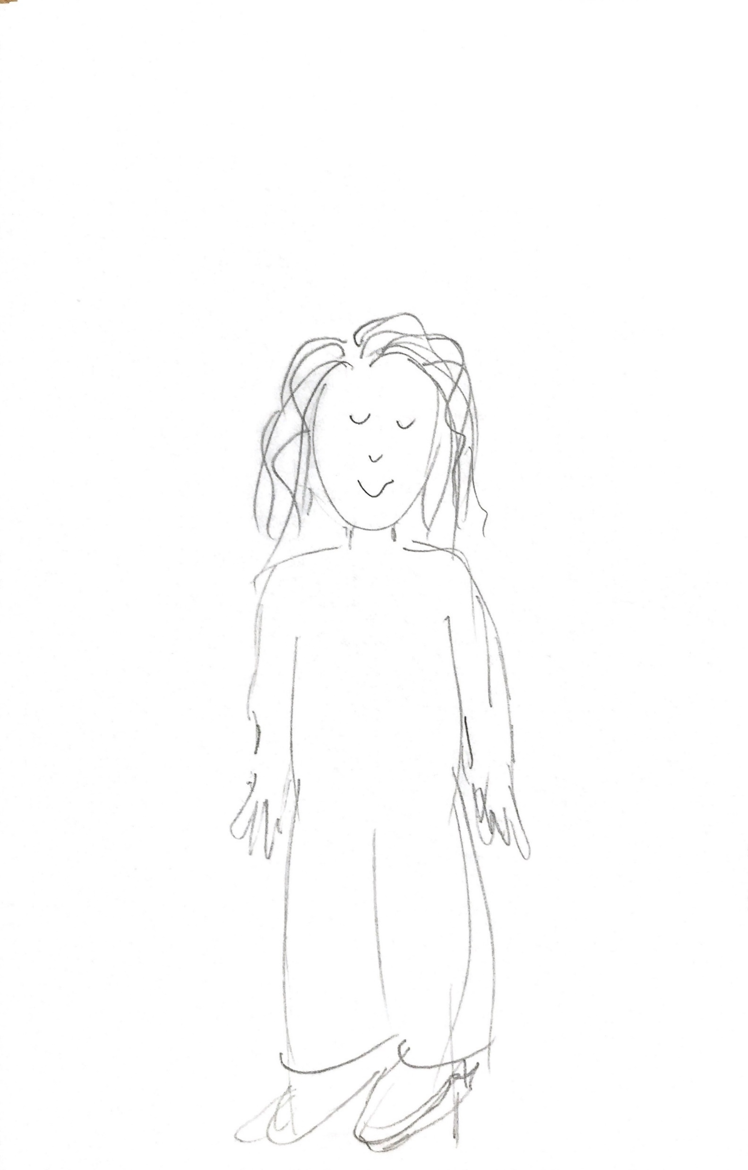
#8: What similarities do you see between yourself and your favorite tree?
Like a tree, I am comforting to those around me.
Notes:
#8 What similarities do you see between yourself and your favorite tree?
Think about how can you combine the two images? Use some of the elements identified on your worksheets to represent aspects of the body.
On a separate sheet of paper combine the 2 images to visualize the tree/self metaphor.

Slide 14
If you filled in multiple statements, review them and circle the one that you like best. It should be the one that makes you feel powerful, confident and inspired when you read it.
The above statement can now serve as your artist statement. Use this phrase, along with all of your responses on the worksheet, to inspire your Love Your Tree creative submission.
Notes:
Add your chosen artist statement, “Like a tree,….”
Use some of the keywords and prompts that you selected while working on the worksheet. List a few different artist statements on the back of your worksheet.

Slide 15
Creative Brainstorm!
Let’s Get Creative…
Notes:
Now we are going to create our final work of art. This may be any form of art that you feel comfortable creating. Posters, Paintings, Drawings, Poems, Stories, or Lyrics, Audio or visual movements are all welcome.
DIRECT THE PARTICIPANTS TO CREATE BASED ON THE MEDIUMS YOU HAVE AVAILABLE.
“Take out your poster sheet and markers and lets allow the thoughts, feelings and words to flow.”

Slide 16
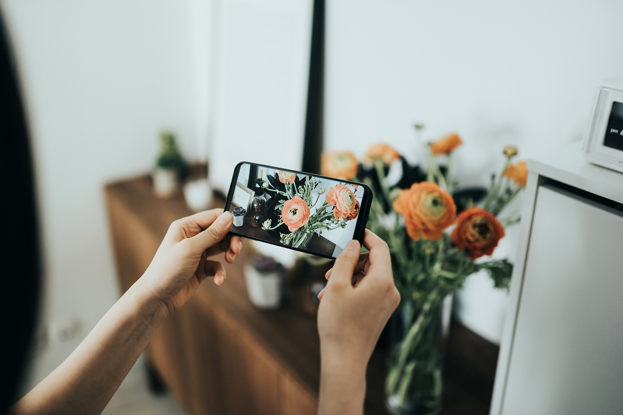
Submit your LYT Entry…
Here are some tips for submitting various forms of artwork:
Visual 2D or 3D artwork (posters, paintings, drawings, graphic design, etc.)
Submit photo file (JPEG, PNG)
• Written works of art (poems, stories, lyrics, etc.)
Submit document file (.doc or PDF)
• Visual/Movement performances (spoken word, choreographed dance, theatrical performance, etc.)
Submit video file (MP4, FLV, MOV or AVI)
• Audio/Spoken/Musical performance (instrumental composition, song lyrics, etc.)
Submit audio or video file (MP3, MP4, FLV, MOV or AVI).
Take a photo or video of your final creative piece and submit to the campaign.
Notes:
The final step in our workshop is to submit your entry. Take a photo or video and submit it online.

Slide 17
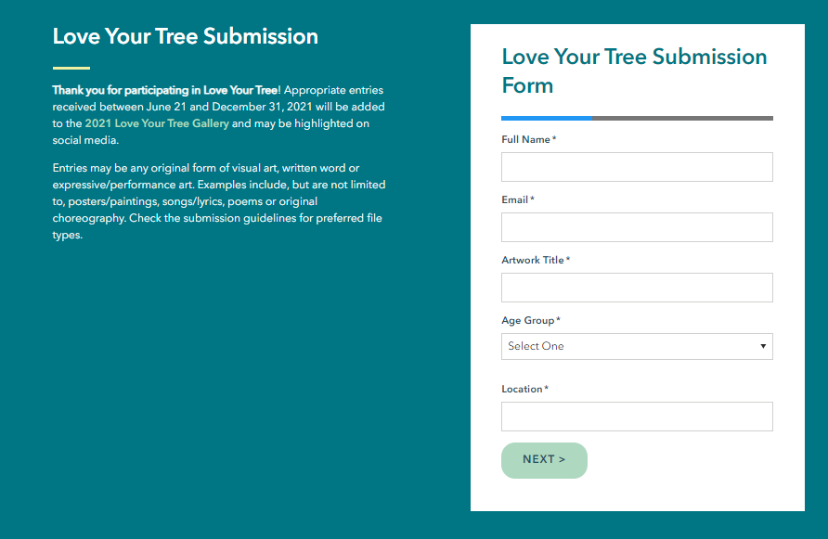
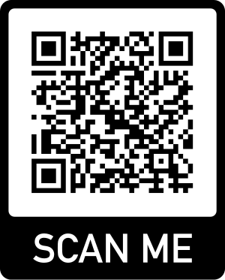
2 Ways to Submit your LYT Entry…
Upload your file directly to the www.LoveYourTree.org website and complete the online consent form.
~ OR ~
Send us an image of your creation via email to LoveYourTree@ercpathlight.com
Notes:
Take out your phone and snap a photo of what you have created right now!
While we are together today those that make submissions will receive a submission prize!

Slide 18
Thank you for participating in Love Your Tree!
Questions? Comments?
Email us at LoveYourTree@ERCPathlight.com
Accompanying Resources/Handouts
Available to download at LoveYourTree.org
Artwork by: Emily Raulie

